Slide 1



Integrated Program in Business Analytics
Customer Sentiment Analysis for Hotels in Europe
IPBA_B11_GROUP A
Mentor: Mr. Karthik Vadhri
Team Members:
Anjali Kashyap
Chinmay Pisu
Nitesh Yadav
Parul Saigal
Tunisha Singhania
Pratik Kalantri
Ravi Raj

Slide 2
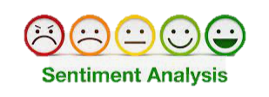
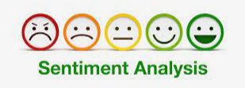
Business Problem and Objectives
TripAdvisor suggests that 81% of people frequently or always read reviews before booking a hotel.
This statistic suggests that customer reviews play an important role in the Hospitality sector. When it comes to booking a hotel, it serves as a reliable source of information about the hotel experience, for a potential customer.
Every review portrays customer experience and associated sentiments either positive or negative which impacts the hotel’s reputation and customer bookings.
Hence it is immensely important for Hotels to analyze customer reviews and evaluate customer sentiments to understand customer expectations, identify critical issues in real time, which aspects of their service need improvements, how are competitors performing and take curative steps to improve customer experience and reduce any dissatisfaction.

Slide 3
Business Problem and Objectives
Business Problem
How to analyze online customer reviews to evaluate positive and negative sentiments of hotels in Europe.
What are the factors impacting positive and negative sentiments about Hotel ?
How can a hotel analyze its competency among different hotel in a city and improve its experience basis different segments and preferences? [customer segments like Business travel, Leisure travel, travelling Solo, Couple or with Family and the duration of stay at the hotel.]

Slide 4
Business Problem and Objectives
Project scope and objectives
1. Build a model to analyze customer reviews of the hotels and measure the intensity of negative and positive sentiments.
2. Identify leading factors impacting the positive and negative sentiments of the customers.
3 Establish regional average as a benchmark for industry reference and competition mapping.
4. Creating a comprehensive interactive dashboard for Hotels with analysis to assess their customer sentiments, ratings compared to benchmarks.
5. Solutions of this kind will benefit hotels to get insights to improve the customer experience and hotel reputation.
Gauging hotels reputation in the market
Understanding a hotel’s flaws
Analyzing competitors
Reviewing all data in a single go

Slide 5

Detailed Project Workflow
Sourcing the data for sentiment analysis
Exploratory Data Analysis
Hypothesis Testing
Data cleaning
Tag Analysis
Data Preparation
Tokenization and Lemmatization
Sentiment Analysis Modelling
Word cloud formation and Benchmarking
Dashboard

Slide 6
Exploratory Data Analysis
Data Dictionary
S.No | Column Names | Details
1 | Hotel_Address | Address of hotel.
2 | Review_Date | Date when reviewer posted the corresponding review.
3 | Average_Score | Average Score of the hotel, calculated based on the latest comment in the last year.
4 | Hotel_Name | Name of Hotel
5 | Reviewer_Nationality | Nationality of Reviewer
6 | Negative_Review | Negative Review the reviewer gave to the hotel. If the reviewer does not give the negative review, then it should be: 'No Negative'
7 | ReviewTotalNegativeWordCounts | Total number of words in the negative review.
8 | Positive_Review | Positive Review the reviewer gave to the hotel. If the reviewer does not give the negative review, then it should be: 'No Positive'
9 | ReviewTotalPositiveWordCounts: | Total number of words in the positive review.
10 | Reviewer_Score | Score the reviewer has given to the hotel, based on his/her experience
11 | TotalNumberofReviewsReviewerHasGiven | Number of Reviews the reviewers has given in the past.
12 | TotalNumberof_Reviews | Total number of valid reviews the hotel has.
13 | Tags | Tags reviewer gave the hotel.
14 | dayssincereview | Duration between the review date and scrape date.
15 | AdditionalNumberof_Scoring | There are also some guests who just made a scoring on the service rather than a review. This number indicates how many valid scores without review in there.
16 | lat | Latitude of the hotel
17 | lng | Longtitude of the hotel

Slide 7
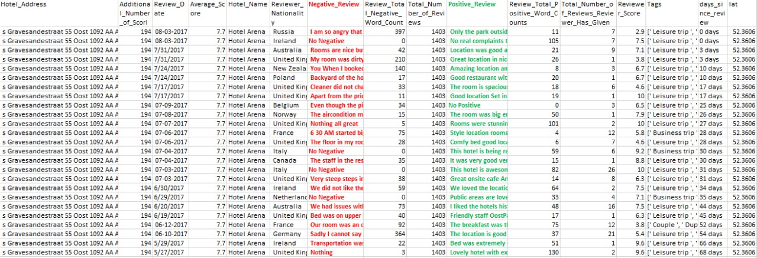
Sample Dataset (515739 x 17)

Slide 8
Performing descriptive statistics for finding insights
There are 1492 unique hotels across 6 cities in Europe – London, Paris, Amsterdam, Vienna, Milan, Barcelona.
There are 35,946 reviews where the user has given only negative reviews.
There are 127,890 reviews where the user has given only positive reviews.

Slide 9
describe function for all non numeric variables
The most frequently reviewed hotel is Britannia Inter -national Hotel Canary Wharf which has 4789 reviews
There are no missing values for object variables.
Number of positive reviews is greater
than negative reviews.
The data has customer reviews for customers from 227 countries.

Slide 11
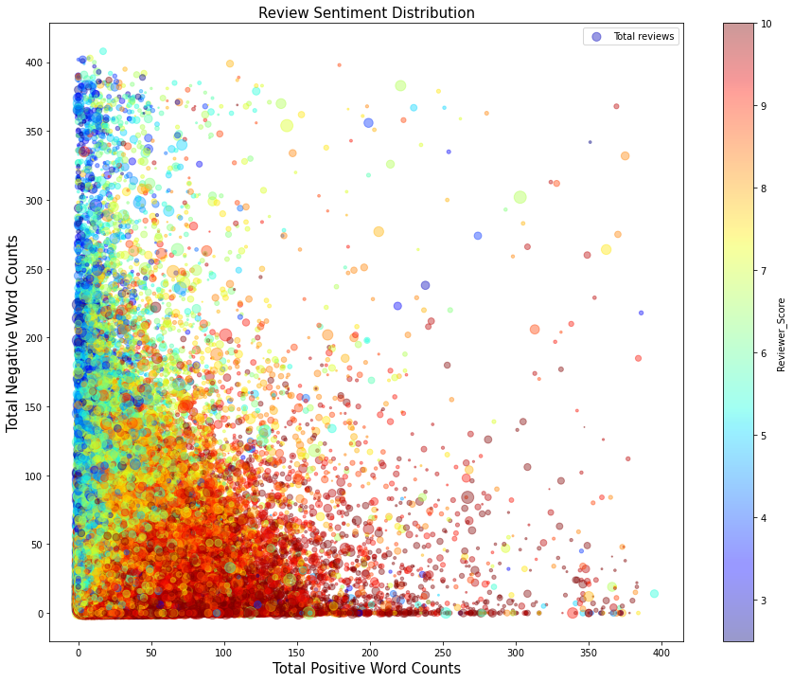
Multivariate and Bivariate Analysis
Total Positive word count 9167995
Total negative word count 9561499
Positive words in review are more than negative words.
As the positive word count in a review is
increasing, the reviewer’s score is also increasing.
As the negative word count in the review is
increasing, the reviewer’s score is decreasing.

Slide 12
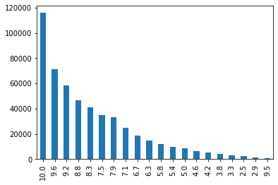
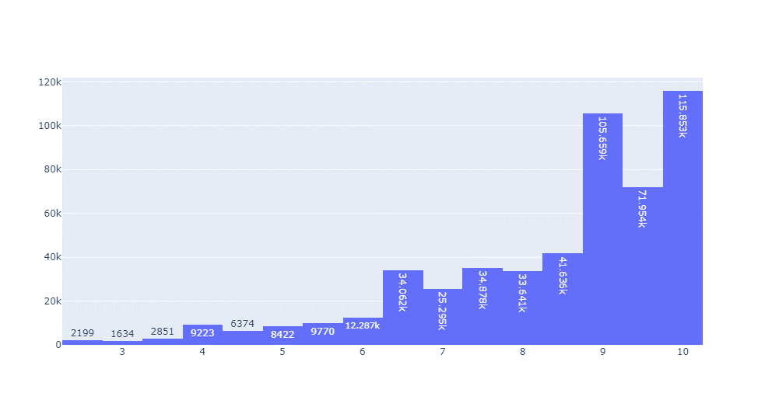
Analysis of reviewer score
After performing some basic analysis on reviewer score we got the following results :-
The mean of Reviewer Score is 8.395 .
The Median of the data is 8.8 .
And the Mode is 10 .
We can also see that the data is Negatively skewed .

Slide 13
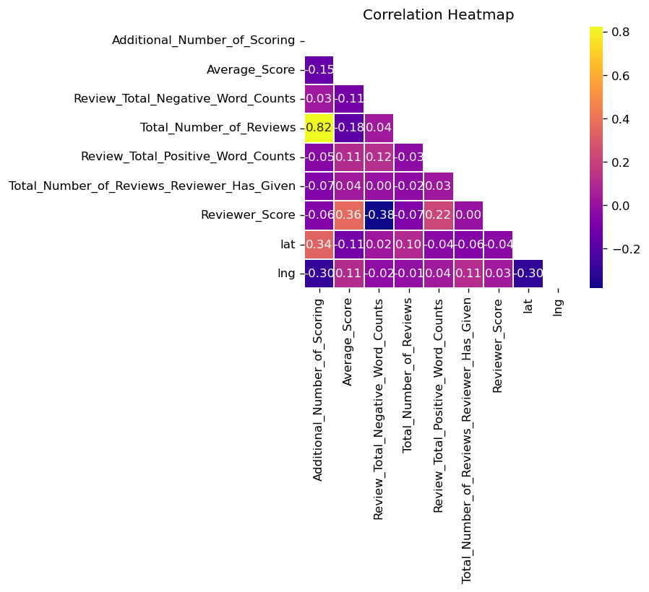
Correlation Heatmap
A correlation heatmap is a graphical presentation representing the correlation between different variables in the data.
By this heatmap we understand a few things :
There is a significant correlation between the Reviewer’s score and Total number of Positive and Negative word counts in a review.
The least related columns
are latitude and
longitude

Slide 14


Hypothesis Testing
Hypothesis testing is a common statistical tool used in research and data science to support the certainty of findings. The aim of testing is to answer how probable an apparent effect is detected by chance given a random data sample.
After performing Chi-Square test on Type of Traveler and Hotel city we conclude that there is an impact of location of the hotel on reviewer score . We used null hypothesis as location has no impact on type of traveler and alternate as there is an impact .
By ANOVA single factor and Post HOC Test on traveler type and reviewer score we conclude that different travelers have different sentiments and have given different rating. We used null hypothesis as there is no difference in between the reviewer Score of different Traveler Type alternate as there is a difference
By performing ANOVA Single factor on reviewer score of all cities and T – test for comparing different cities we conclude that for all the cities reviewer Scores are different. We used null hypothesis as there is No relation between Trip Type and Review Rating and alternate as there is a relation .
After performing ANOVA Single factor , t – test , z- test on trip type and reviewer score we got an insight that different Trip type have different reviewer score and there is also a major difference between the count of Trip type . We used null hypothesis as there is no difference in between the reviewer Score of different cities and alternate as there is a difference

Slide 15


Data Cleaning
Treating missing values - As only 3268 values are missing for longitude and latitude . Hence we decided to skip this as these 3k rows are just 0.025% of the entire count
We removed “No Positive” & “No Negative” from Positive review column & Negative review column respectively
We removed characters, hyperlinks, tags, numbers, whitespaces, and punctuation;

Slide 16
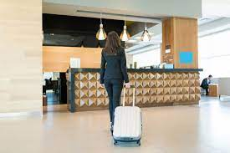
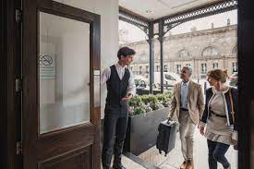


Customer profiling for Hotels
Type of Travel
Business
Leisure
No. of Days Stayed
1 Day
2 Days
3 Days
8 Days
9 Days
Type of Customer
Solo
Travelers with Friends
Group
Couple
Family with Young Children
Family with Older Children
7 Days
5 Days
4 Days
6 Days

Slide 17
Customer profiling – Insights for Hotels
Type of Travel

Slide 18
Customer profiling – Insights for Hotels
Type of Traveler

Slide 19
Customer profiling – Insights for Hotels

Slide 20
Data preparation for sentiment analysis
Stop words filtering from the Negative and Positive reviews
which include articles, pronouns, conjunctions, prepositions. etc. One of the most popular NLP
libraries, NLTK (acronym for Natural Language Toolkit) lists 179 stop words for the English language.
Also appended the below additional stop words relevant to the context of Hotel reviews analysis.
[hotel,
Tokenization
breaking the Negative and Positive reviews text into words called ‘tokens’. These tokens help in understanding the context or developing the model for the NLP. The tokenization helps in interpreting the meaning of the text by analyzing the sequence of the words.
Lemmatization — meaning returning a word to its dictionary form. Say, the lemma for swimming, swum, and swam is swim.

Slide 21
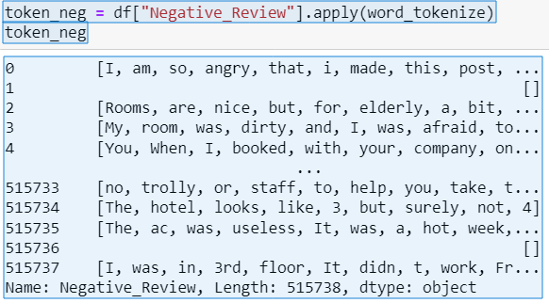
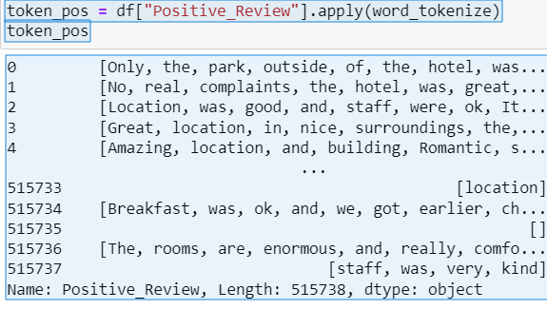
Method used for Tokenization is . apply word tokenizer
Data preparation for sentiment analysis
Tokenization for Negative reviews
Tokenization for Positive reviews

Slide 22
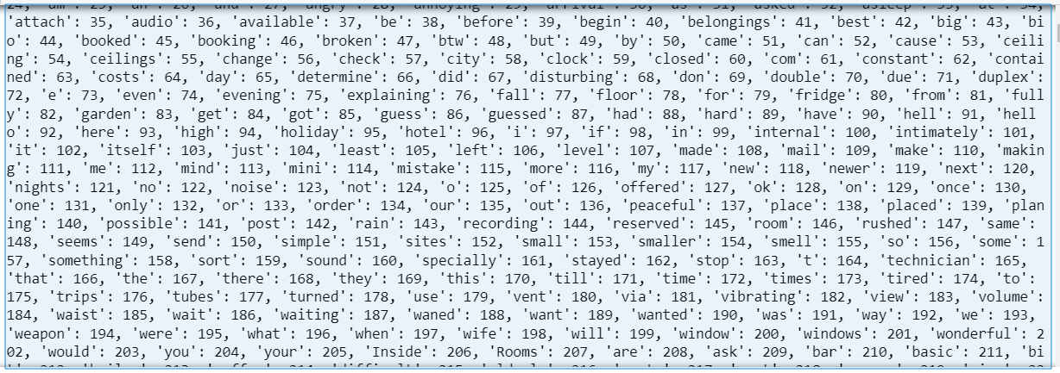
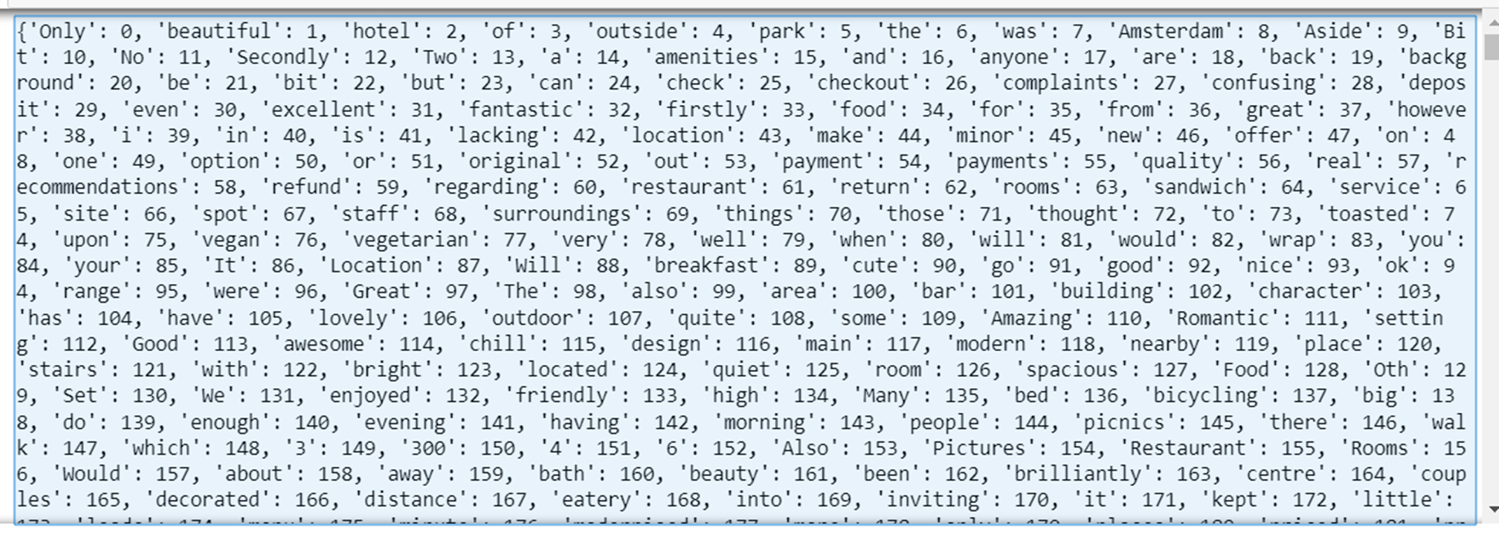
Dictionary of tokens
Negative Tokens
Positive Tokens

Slide 23
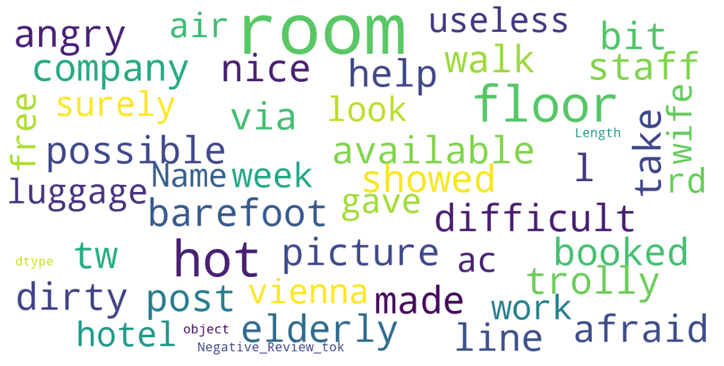
Word cloud
Negative word cloud

Slide 24
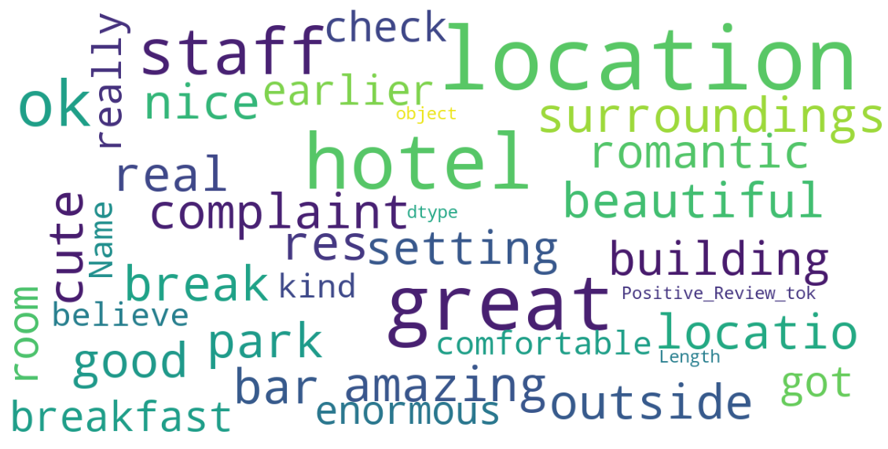
Word cloud
Positive word cloud

Slide 25
Sentiment Analysis Modelling
The model will measure the polarity of the sentiment within the customer review text and also enables the hotels in classification of reviews into a positive or negative opinion.
The model will measure the intensity of Positive and Negative reviews posted by customers on a scale of -1 to 1 represents the positive sentiment.
The sentiment score of a text review is obtained by summing up the intensity of each word in the text. This lexicon approach has a mapping between words and sentiment, and the sentiment of a review is the aggregation of the sentiment of each term.
The sentiment scores are also very useful in estimating the scale of impact of the factors contributing to the negative and positive feedbacks.

Slide 26

Sentiment Analysis Modelling
In this project, we have used Valence Aware Dictionary for Sentiment Reasoner (VADER) to evaluate intensity of the sentiments expressed in data.
VADER analyzer calculates text sentiment and produces four different classes of output scores: positive, negative, neutral, and compound.
Here, we will make use of the Compound Score. A compound score is the aggregate of the score of a word, or precisely, the sum of all words in the lexicon, normalized between -1 and 1.
This developed model issued to calculate the frequency of each term and provide scoring for based on its intensity.
VADER, is a simple rule based model for general sentiment analysis and compared its effectiveness to 11 typical state-of-the-practice benchmarks, including
Affective Norms for English Words(ANEW)
Linguistic Inquiry and Word Count (LIWC)
The General Inquirer
Senti WordNet

Slide 27
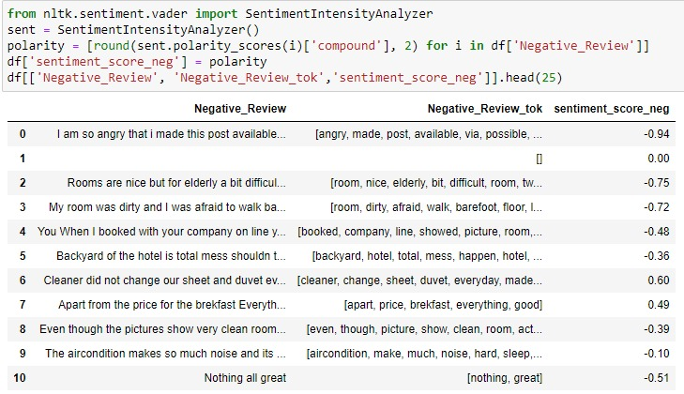
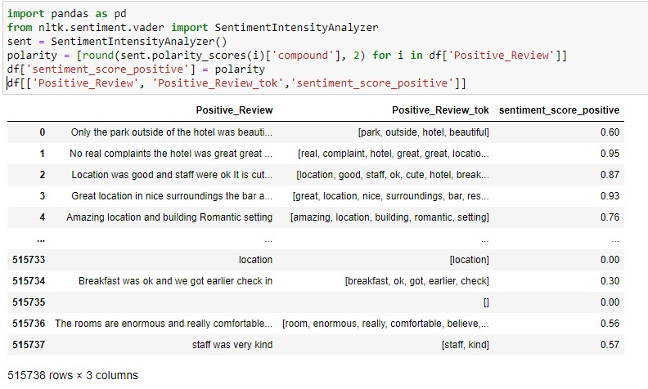
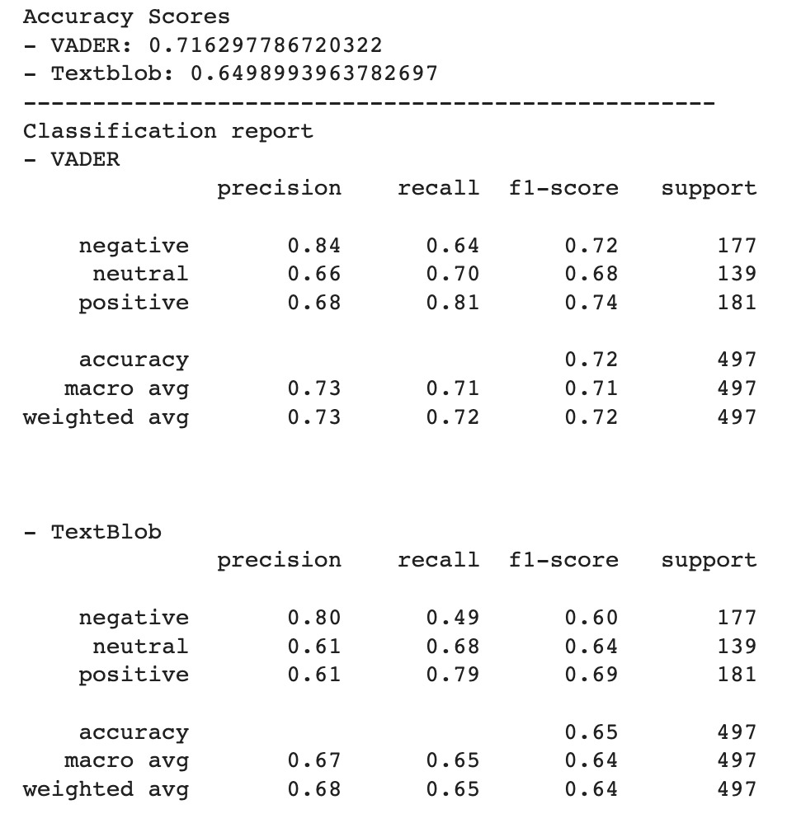

Slide 28


Benchmarking
In this project Reviewer’s score and Sentiment scores have been benchmarked at City’s average for various customer segments and is used in the Hotel dashboards to get a detailed report about their relative performance compared to city benchmarks(average)
Insights after Benchmarking city and trip type :-
For all location Average reviewer score is higher for Leisure trip than business trip.
Highest % ratio of business trip volume is from Milan followed by London and
Vienna
Highest rating given by customers for Business trip in Vienna and lowest is for London
Highest rating given by customers for Leisure trip in Barcelona and lowest
is for London
There is a possibility that London is in the least rated for both Business and Leisure is because 51% of data sets is for London

Slide 29

Benchmarking
Insights after Benchmarking trip type across cities with reviewer score :-
For business trip across Europe we see that highest average reviewer's score is for solo followed by couple and group.
For business trip within Europe, Milan has the highest count.
For leisure trip across the cities, couples have the max contribution -50% and the lowest contribution is from travelers with friends' < 1%
For business trip across the cities, Solo travelers have the max contribution (7%-12%) and the lowest contribution is from travelers with friends' (< 0.5%)
Solo travelers have the max contribution for business trip across the cities
Top 3 categories for business trip across the cities- Solo, couple and group (in terms of volume)
Top 3 categories for leisure trip across the cities- Couple, Group and family with young children

Slide 30

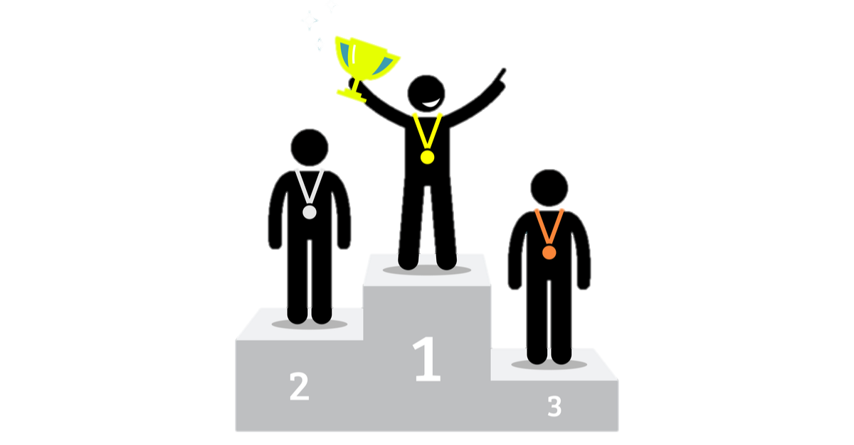
Benchmarking
Insights after Benchmarking city and type of traveler :
across all cities , couple has the highest Average rating compared to others.
Vienna has the highest average couple rating
solo travelers has rated least for city Barcelona followed by Amsterdam, Milan & London
Vienna and Paris has the least rating given by family with younger kids
Insights after Benchmarking Days stayed :
London is the only city where we see more than 50% of people stay for 1 day
As For other city we see that almost 50% of travelers stay for 2 to 3 days
As the number of days increases reviewer score decreases
Review is higher for days 1,2 and 3

Slide 31
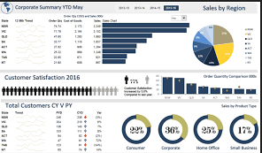

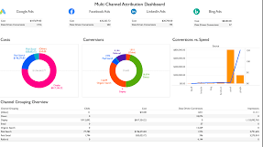
Dashboard
The dashboard is the User Interface(UI) for Hotels to get a detailed report about their relative performance compared to city benchmarks(average)
Hotel can easily evaluate from the report if their services and experience have been rated above or below the average on Reviewer’s score and Sentiment scores in various customer segments like Business travel, Leisure travel, travelling Solo, Couple or with Family and the duration of stay at the hotel.
Very useful to them to engage deeper with these customers and personalize their services to improve the reviewer’s scores and significantly reduce the negative sentiments in future for good reputation and feedbacks.
More importantly identify the leading factors impacting the high negative and positive sentiments and build a plan to leverage their strengths and improve where there is dis-satisfaction in their customers

Slide 32
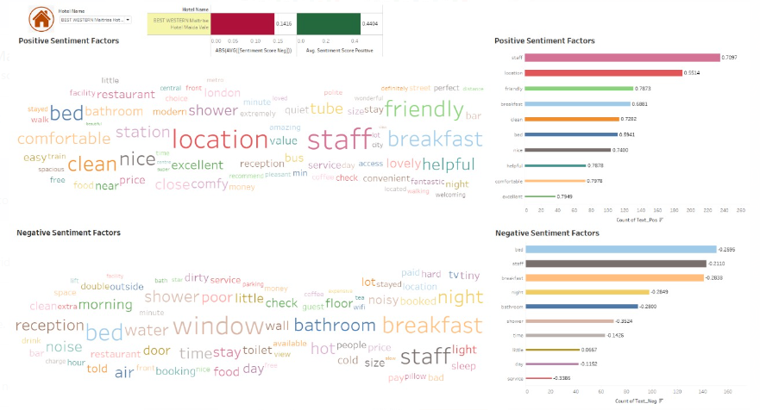
Dashboard
Example 1
Shows the Top factors/topics impacting the negative and positive sentiments for the Hotel Best Western Maitrise.
Customers have are liking the Hotel’s location.
2. Hotel has to focus improving on the beds, breakfast, bathrooms/ showers as they are top factors generating negative sentiment and dis-satisfaction.
Example 1
Shows the Top factors/topics impacting the negative and positive sentiments for the Hotel Best Western Maitrise.

Slide 33
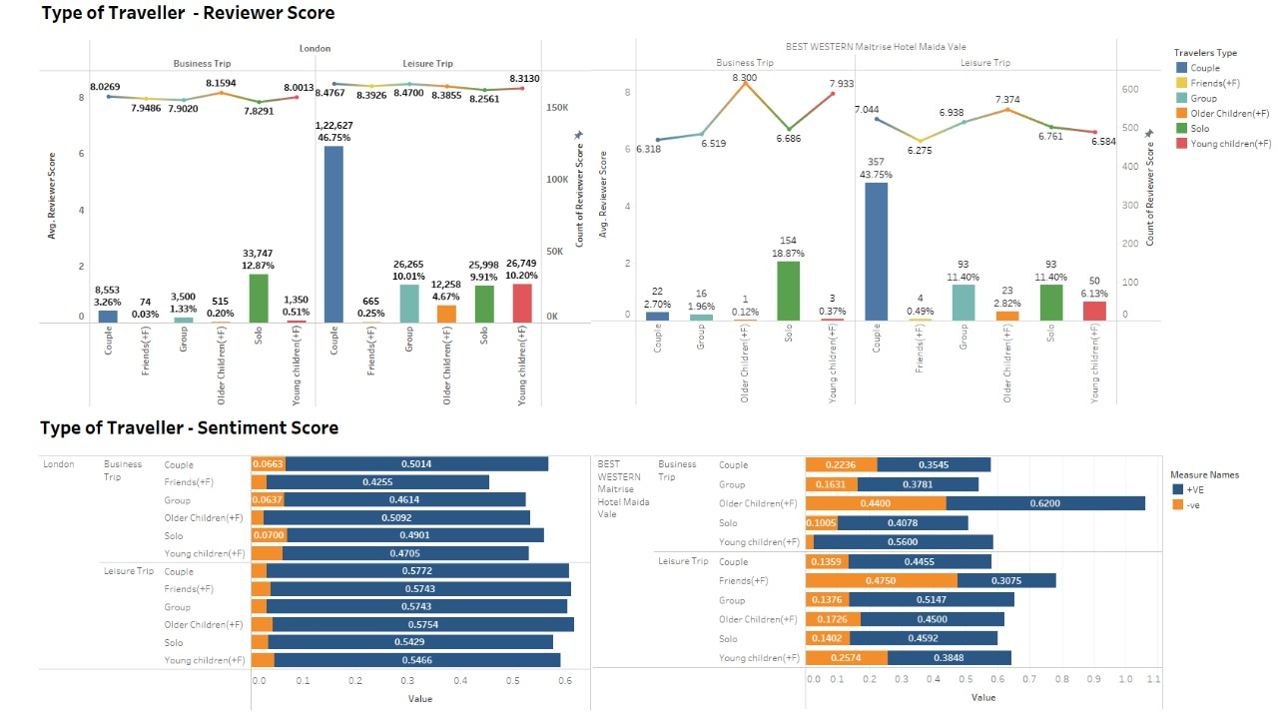
Dashboard
Example 2
The hotel has received rating below the city benchmark.
2. Also the analysis shows that Hotel is generating higher negative sentiments and lower positive sentiments compared to city benchmark.

Slide 34
Thank You
Links :-
Dataset :- https://drive.google.com/file/d/15ROoGdYBMX29Czaft-mb3hXYh_DGVWqk/view?usp=drive_link
Hypothesis & benchmarking : - https://docs.google.com/spreadsheets/d/1lLI33mXOjZnH8M7Qs5NTYjvHjy8crnK1/edit?usp=drive_link&ouid=112231465881565299719&rtpof=true&sd=true
Tableau Dashboard :- https://drive.google.com/file/d/1ecfkGn2T6XbCEuD417VnkdpeHWH6-TcN/view?usp=drive_link
Python Script :- https://drive.google.com/file/d/1wlgfOzeIln6sgzl1cqJUvqTGfPBy2apI/view?usp=drive_link
These are links to google drive as the size of dataset and dashboard is huge and cannot be uploaded to github .

